Slide 1

A Project Review Meeting on Airline Ops Briefing Dashboard
By
Name: Kasireddy Srihita roll no: 2520030153
Name: Yasasri roll no: 2520030373
Team Number: 1
Under the guidance of
Dr. Pavitra D
Assistant Professor
Department of Computer Science and Engineering
Koneru Lakshmaiah Education Foundation (Deemed to be University estd. u/s. 3 of the UGC Act, 1956) Off-Campus: Bachupally-Gandimaisamma Road, Bowrampet, Hyderabad, Telangana - 500 043. Phone No: 7815926816, www.klh.edu.in

Slide 2
Outline of the Presentation
Abstract
Introduction
Problem Statement
Project Flow Diagram
Objectives with Justification
Modules[Frontend web pages]
Expected Outcomes of the Proposed Work
Conclusion
References

Slide 3
Abstract
Airline Ops Briefing Dashboard is a web-based airport operations monitoring system designed to provide airport managers and operational staff with a centralized platform for monitoring daily airport activities. The system focuses on critical operational parameters such as slot utilization, flight delays, staffing information, weather conditions, gate occupancy, and operational alerts.
The dashboard integrates multiple monitoring modules into a single interface, enabling efficient tracking and visualization of airport operations. Interactive user interface components, real-time notifications, and analytical dashboards improve situational awareness and assist decision-makers in managing airport resources effectively. The project demonstrates the implementation of modern front-end development concepts through a responsive and user-friendly web application.

Slide 4
Introduction
Modern airports manage a large number of operations simultaneously, including flight scheduling, gate allocation, weather monitoring, staffing management, and operational reporting. Efficient coordination of these activities is essential for ensuring smooth airport functioning and minimizing operational disruptions.
Traditional monitoring approaches often involve multiple independent systems, making it difficult for airport managers to obtain a complete operational overview. The Airline Ops Briefing Dashboard addresses this challenge by providing a centralized platform that consolidates important operational information into a single dashboard. This improves monitoring efficiency, resource management, and decision-making capabilities.

Slide 5
Problem Statement
Airport operations involve numerous interconnected activities that require continuous monitoring and coordination. Information related to flight schedules, delays, gate utilization, staffing availability, weather conditions, and operational alerts is often distributed across multiple systems.
The absence of a centralized monitoring platform can lead to delays in decision-making, inefficient resource allocation, and operational conflicts. Airport managers require a unified solution that provides real-time visibility into critical operational metrics.
The Airline Ops Briefing Dashboard aims to solve these challenges by offering an integrated platform for monitoring airport operations and supporting effective operational decision-making.

Slide 6
Objectives with Justification
Objectives
To provide a centralized airport operations monitoring platform.
To monitor slot utilization and operational performance.
To analyze flight delays and operational disruptions.
To track staff availability and workforce management.
To monitor weather conditions affecting airport operations.
To detect gate conflicts and resource allocation issues.
To provide real-time notifications and operational alerts.
To support airport managers in making informed decisions.
Justification
These objectives improve airport operational efficiency by providing real-time visibility into critical activities. The dashboard helps reduce response times, optimize resource utilization, improve operational awareness, and support effective airport management.

Slide 7
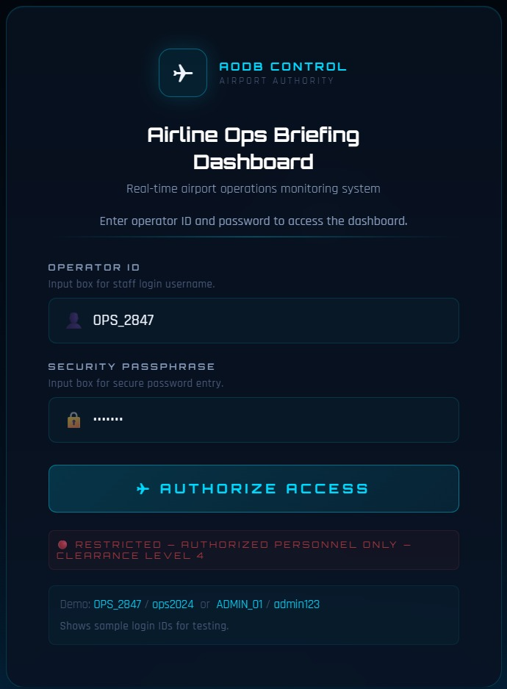
Modules [Frontend web pages]

Slide 8
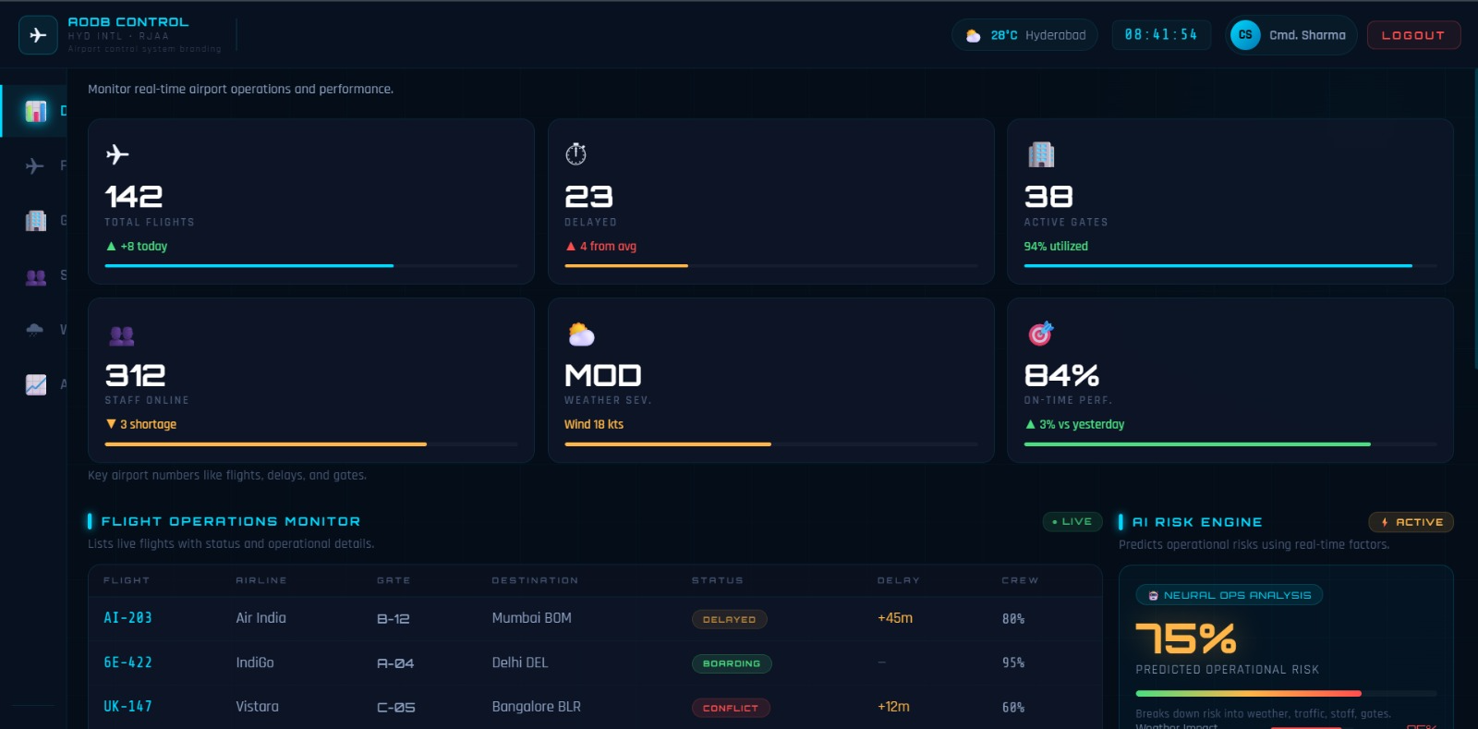

Slide 9
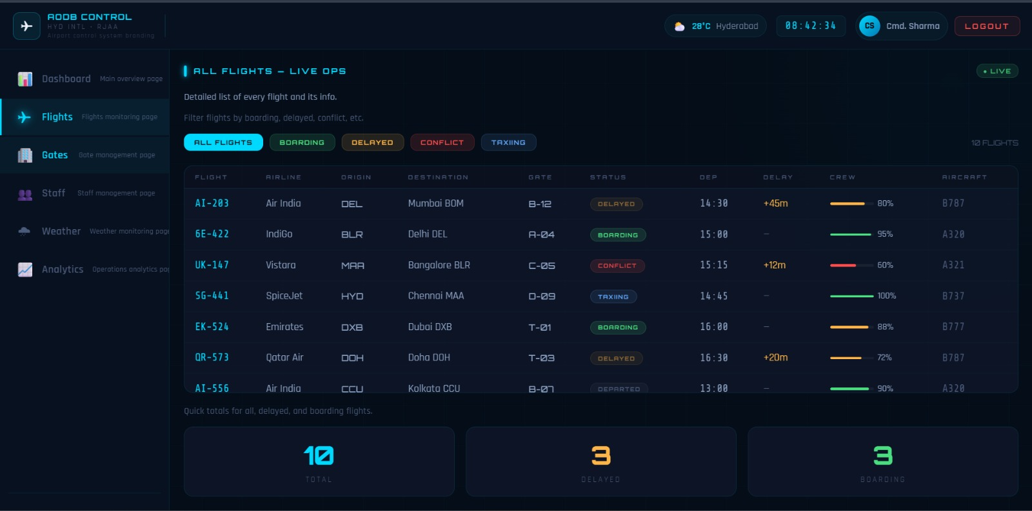

Slide 10
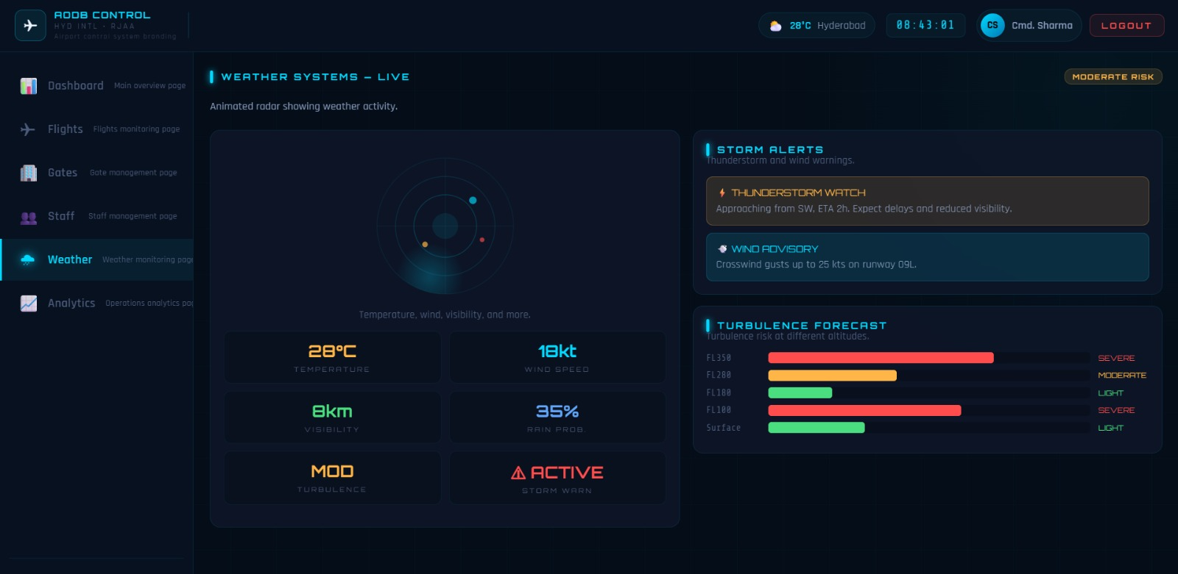

Slide 11
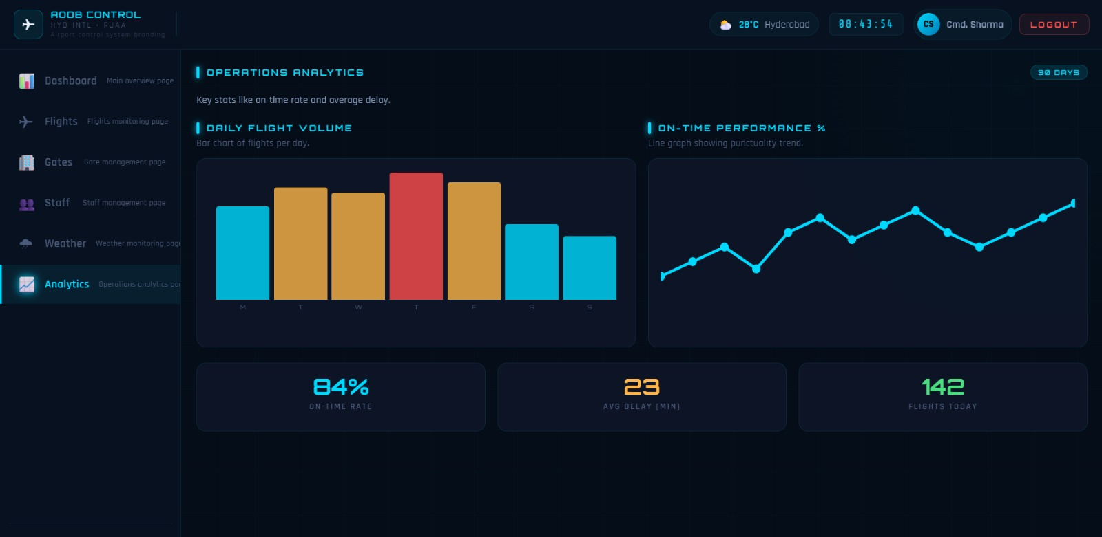

Slide 12
CO MAPPING
Course Outcome | Project Feature | Justification
CO1 | Dashboard architecture, reusable components | Uses component-based UI and modular front-end design.
CO2 | ES6 modules, import/export, folder organization | Project follows modern JavaScript architecture with reusable modules.
CO3 | React components, Props, Routing | Built using React functional components, JSX and React Router.
CO4 | Authentication Context, State Management | Uses Context API, React Hooks (useState, useContext), protected routes and state management.
CO5 | Navigation, Login, Responsive UI | Implements SPA navigation, protected pages and user-friendly interface.
CO6 | Vite Project Structure | Built using Vite with production-ready project organization and deployment support.

Slide 13
Expected Outcomes of the Proposed Work
Improved airport operational visibility.
Better monitoring of flight schedules and delays.
Efficient slot utilization analysis.
Improved workforce and staff management.
Faster detection of operational conflicts.
Better awareness of weather-related disruptions.
Improved resource allocation and gate management.
Real-time notification and alert generation.
Enhanced decision-making capabilities.
Centralized access to operational information.

Slide 14
Conclusion
Conclusion and Future Scope
The Airline Ops Briefing Dashboard provides a centralized and efficient platform for monitoring airport operations. The system integrates multiple operational modules including slot utilization monitoring, delay analysis, staffing management, weather tracking, gate conflict detection, and real-time notifications.
The project successfully demonstrates modern front-end development principles through an interactive and responsive user interface. By consolidating operational information into a single dashboard, the system improves visibility, efficiency, and decision-making capabilities.

Slide 15
Future Scope
Migration to React.js architecture.
Integration with backend services using Node.js and Express.js.
Database connectivity using MySQL.
Real-time API integration for flight and weather data.
AI-based operational analytics and forecasting.
Mobile application support.
Advanced reporting and data visualization capabilities.

Slide 16
References
HTML5 Documentation
CSS3 Documentation
JavaScript Documentation
MDN Web Docs
Front-End Development Frameworks and UI Engineering Course Material
Dashboard Design Principles and Best Practices
Responsive Web Design Guidelines
Visual Studio Code Documentation

Slide 17
Thank you

